Slide 1
Employee Attrition Problem
Chetana Chaudhari
Takenmind - Global Internship

Slide 2
Problem Statement
The data is for company X which is trying to control attrition. There are two sets of data: “Existing employees” and “Employees who have left”.
Following attributes are available for every employee.
Satisfaction level (0–1)
Last evaluation (Time since last evaluation in years)
Number of projects completed while at work
Average monthly hours at workplace
Time spent at the company in years
Whether the employee had a workplace accident
Promotion last 5years (Whether the employee was promoted in the last five years)
sales (Department in which they work for)
Relative level of salary
Whether the employee left the workplace or not (1 or 0)

Slide 3
Objective of Project
To determine what type of employees are leaving.
To determine which employees are prone to leave next.

Slide 4
Few observations about dataset Input
Dataset has record of employees in company X having 9 attributes.
Out of which, 3571 employees have already left company, while 11427 employees still working in company.
Extra attribute can be added: ‘left’(0/1) to check if employee have already left company.

Slide 5
What type of employees are leaving?

Slide 6
Data Exploration
Finding out mean of all attributes of employee, few observations are made:
The average satisfaction level of employees who stayed with the company is higher than that of the employees who left.
The average monthly work hours of employees who left the company is more than that of the employees who stayed.
The employees who had workplace accidents are less likely to leave than that of the employee who did not have workplace accidents.
The employees who were promoted in the last five years are less likely to leave than those who did not get a promotion in the last five years.

Slide 7
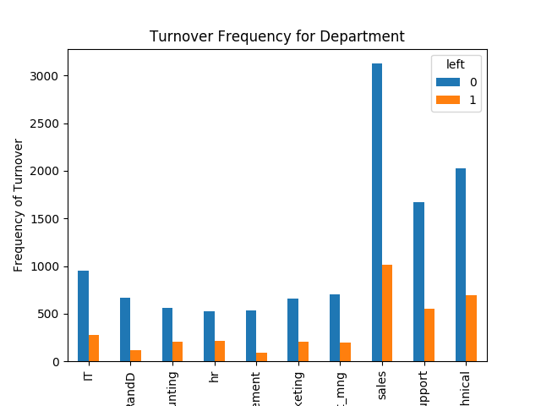
Continued..
It is evident that the frequency of employee turnover depends a great deal on the department they work for. Thus, department can be a good predictor of the outcome variable.
Departments with maximum frequency turnover are:
Sales
Technical
Technical support

Slide 8
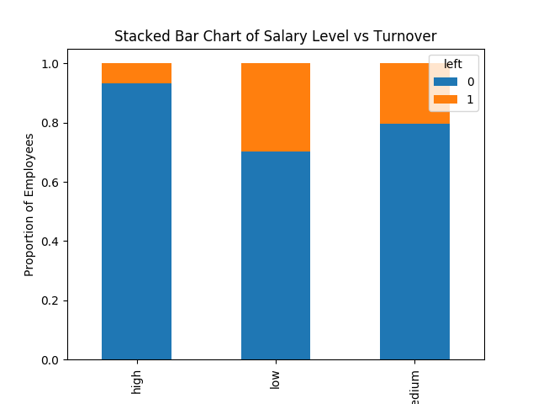
employee salary level and the frequency of turnover
The proportion of the employee turnover depends a great deal on their salary level.
Most of employees might have left company due to low salary.

Slide 9
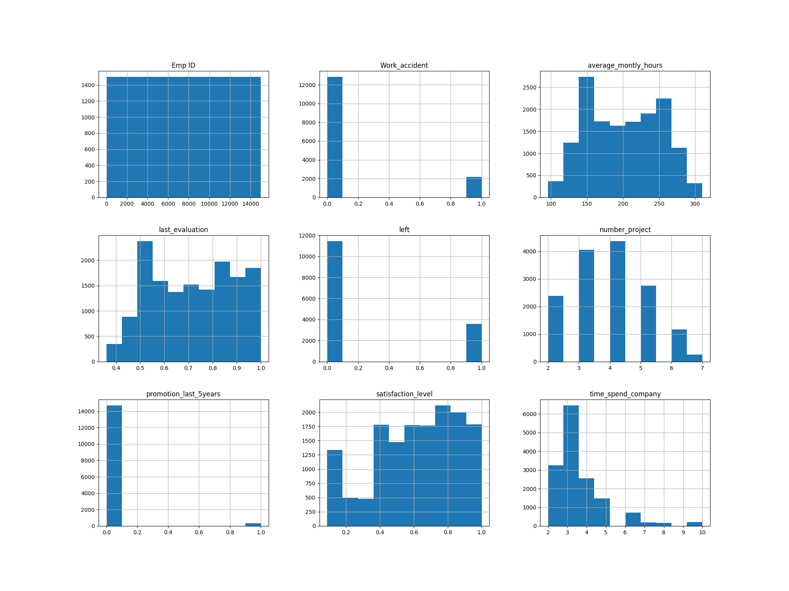

Slide 10
Histograms for exploratory phase:
Histograms are often one of the most helpful tools we can use for numeric variables during the exploratory phrase.
Histograms clearly gives vision of factors which are affecting employee attrition.
Factors like promotion from last 5 yrs, work accident doesn’t affect attrition directly.
While factors like satisfaction level, number of projects, hours spent in company can affect attrition on high level.

Slide 11
K-means clustering analysis
Let's find out the groups of employees who left. You can observe that the most important factor for any employee to stay or leave is satisfaction and performance in the company. So let's bunch them in the group of people using cluster analysis.

Slide 12
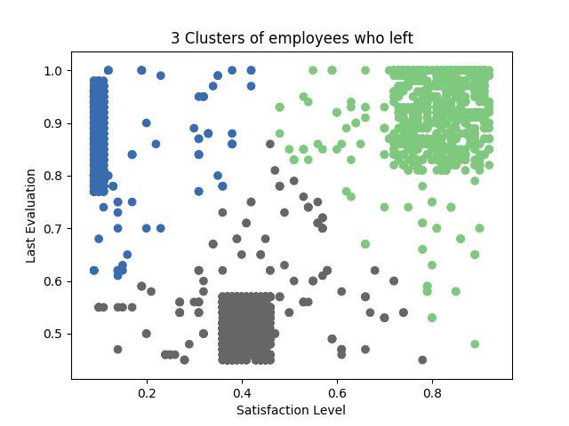
Clustering
Here, Employee who left the company can be grouped into 3 type of employees:
High Satisfaction and High Evaluation(Shaded by green color)
Low Satisfaction and High Evaluation(Shaded by blue color(Shaded by Blue color)
Moderate Satisfaction and moderate Evaluation (Shaded by grey color)

Slide 13
Determine which employees are prone to leave next.
Using Random forest tree Model

Slide 14
Building a Classifier using Scikit-learn
You can create dataset of employees by merging both datasets of employess already left and existing employee.
xlfile=pd.ExcelFile('TakenMind-Python-Analytics-Problem-case-study-1-1.xlsx') dframe1=xlfile.parse('Existing employees') dframe1['left']=np.zeros((len(dframe1.index),), dtype=np.int) #print(dframe1) dframe2=xlfile.parse('Employees who have left') dframe2['left']=np.ones(len(dframe2.index),dtype=np.int) #print(dframe2) employee=pd.concat([dframe1,dframe2],ignore_index=True) #print(employee) employee.to_csv('dataset.csv',sep=',')
Dataset can be split into two parts for testing and training purpose.
X=employee[['Emp ID','satisfaction_level','last_evaluation','number_project','average_montly_hours','time_spend_company','Work_accident','promotion_last_5years','dept','salary']] # Features y=employee['left'] # Labels X_train, X_test, y_train, y_test = train_test_split(X, y, test_size=0.3) # 70% training and 30% test

Slide 15
Training model and removing features
After training model, predictions are performed on test dataset. It gives accuracy as follows:
Accuracy: 0.9964444444444445
Precision: 1.0
Recall: 0.9858281665190434
It also gives facility to check important factors:

Slide 17
Generating the Model on Selected Features
After training, check the accuracy using actual and predicted values.
Accuracy: 0.9966666666666667
Precision: 1.0
Recall: 0.9860390905464699

Slide 18
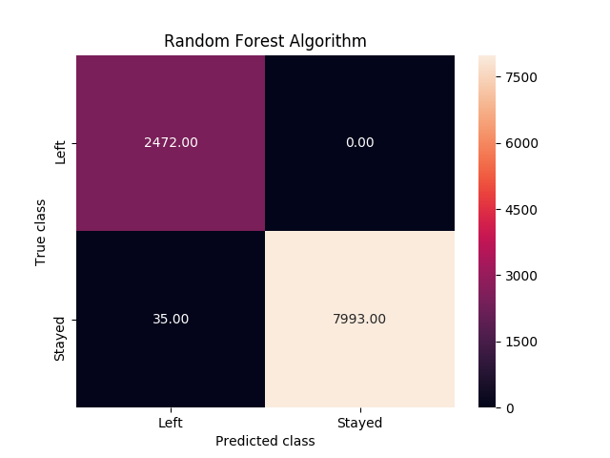
We construct confusion matrix to visualize predictions made by a classifier and evaluate the accuracy of a classification.

Slide 19
Conclusion
According to our Random Forest model, the above shows the most important features which influence whether to leave the company, in ascending order.
Emp ID 0.446306
satisfaction_level 0.215324
number_project 0.109271
time_spend_company 0.089596
average_montly_hours 0.077056
last_evaluation 0.054616

Slide 20
Thank you.

